Slide 1
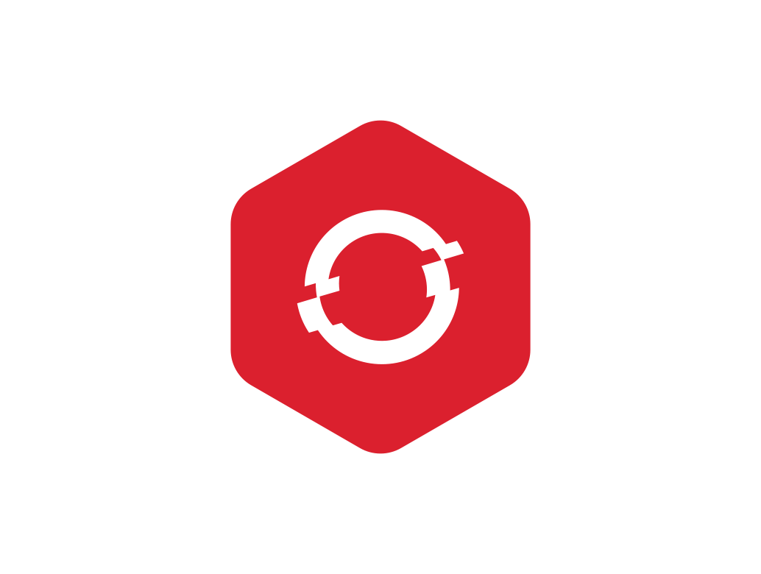
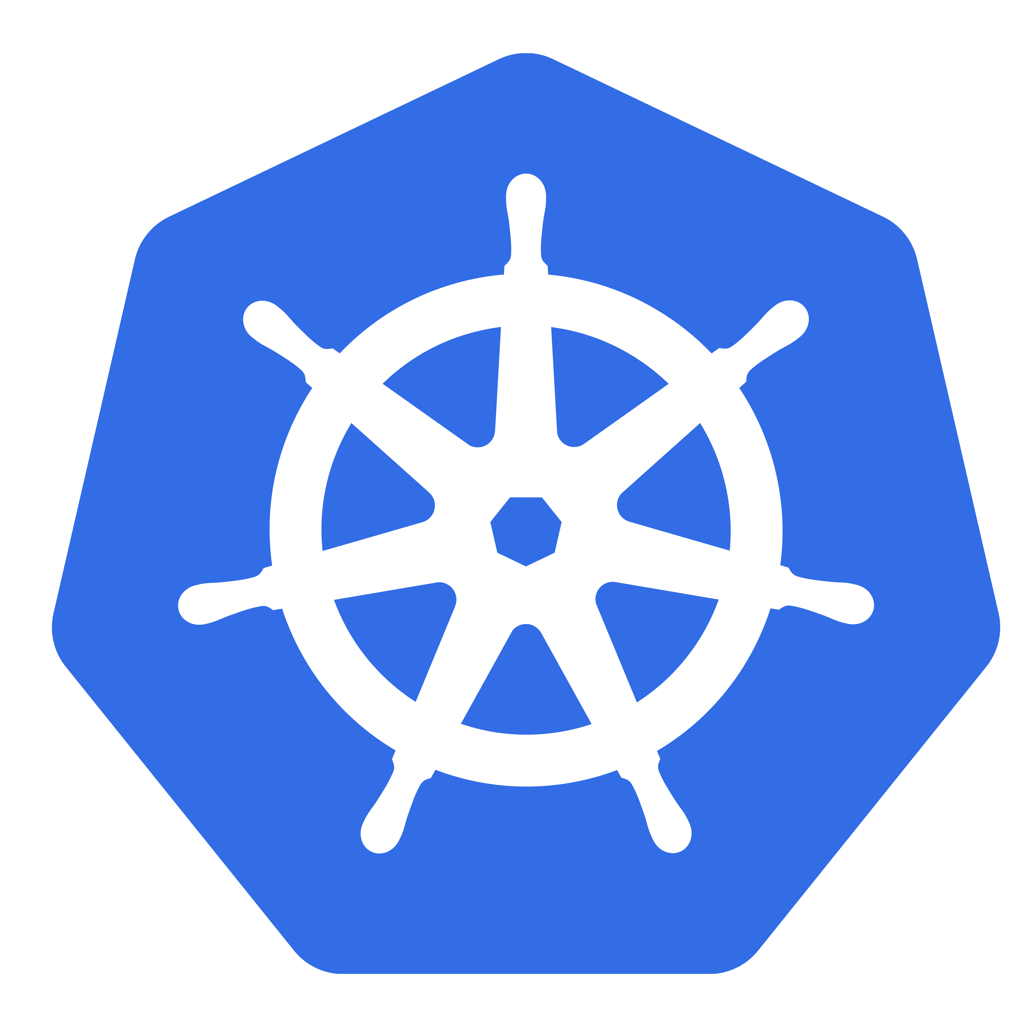
KUBERNETES
By Anish Jain
Orchestrating containers, scaling workloads, and securing applications.

Slide 2
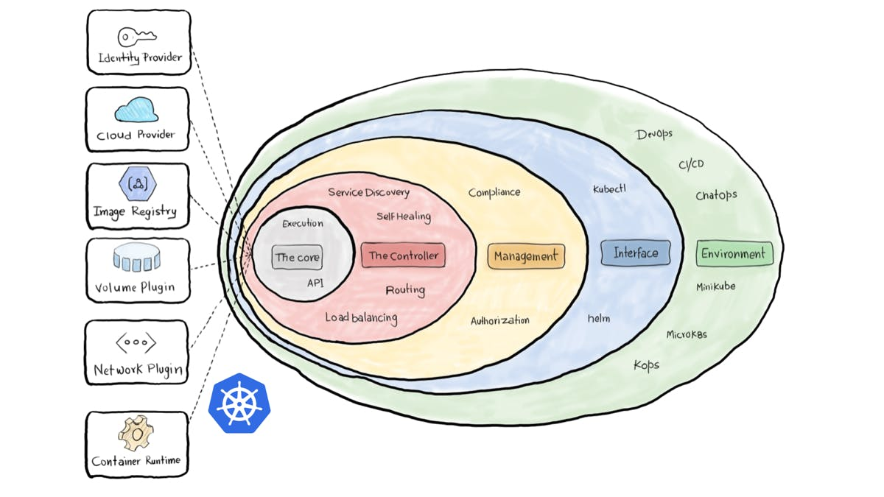
Agenda
Architecture of Kubernetes
Why to use K8s?
Core Objects and API
Networking
Workload
Configuration
Resource Quota
Probes
Volume

Slide 3

Architecture of Kubernetes

Slide 4
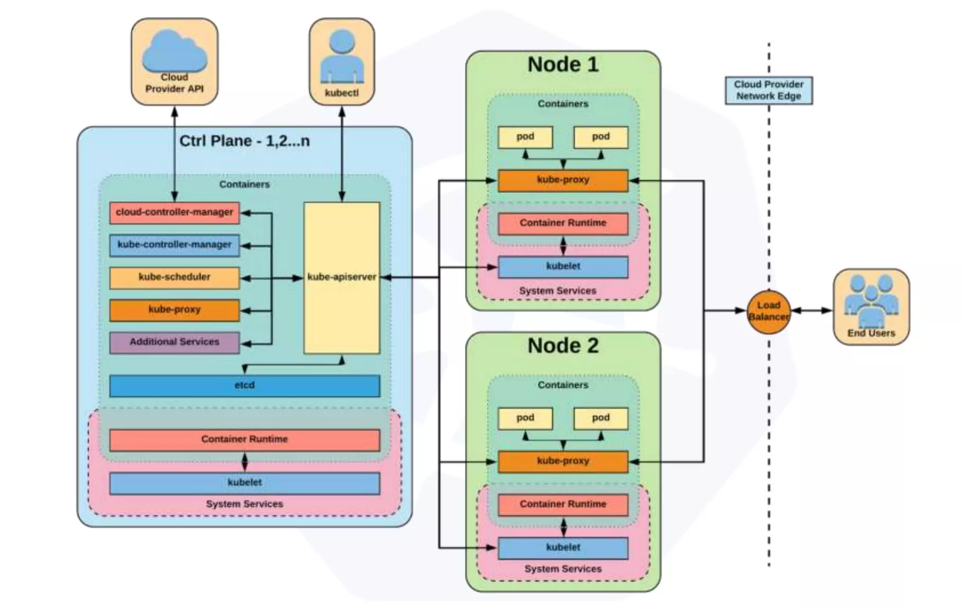

Slide 5
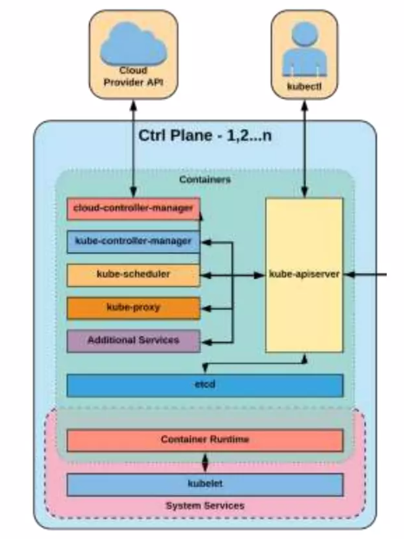
Control Plane Components
kube-apiserver
- Provide REST interface.
- Strictly all client communicate via API server.
- Act as gatekeeper to handle authentication, request validation etc.
Etcd
- Act as cluster data store.
- key-value store for persisting cluster state.
kube-controller-manager
- Steers the cluster towards the desire state
- Node controller, Replication controller, endpoint controller, Service account and token controller
kube-scheduler
- Assigning node for newly created pod
- Scheduling decision: resources required, constraints etc.
cloud-controller-manager
- Node, Route, Service, Volume Controllers

Slide 6
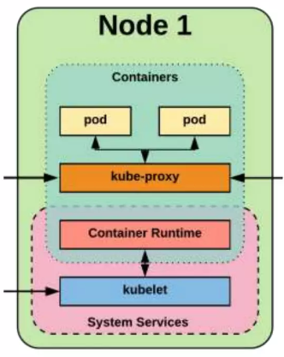
NODE Components
Kubelet
- An agent that runs on each node in the cluster. It makes sure that containers are running in a pod.
- The kubelet takes a set of PodSpecs that are provided through various mechanisms and ensures that the containers described in those PodSpecs are running and healthy.
kube-proxy
- Manages the network rules on each node.
- Performs connection forwarding or load balancing for Kubernetes cluster services.
Container Runtime Engine
- A container runtime is a CRI (Container Runtime Interface) compatible application that executes and manages containers.
Containerd (docker), Cri-o, Rkt

Slide 7
Why to use K8s?

Slide 8
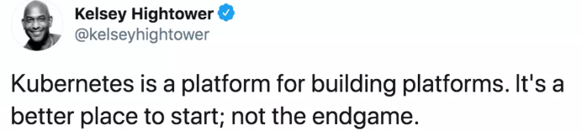
Container Orchestration
Scalability: All services within Kubernetes are natively Load Balanced. Can scale up and down dynamically.
Lower costs
High availability: Used both to enable self-healing and seamless upgrading or rollback of applications.
Portability: enables seamless deployment across diverse infrastructure platforms.

Slide 9
Self Healing
Kubernetes will ALWAYS try and steer the cluster to its
desired state.
Me: “I want 3 healthy instances of redis to always be running.”
Kubernetes: “Okay, I’ll ensure there are always 3 instances up and running.”
Kubernetes: “Oh look, one has died. I’m going to attempt to spin up a new one.”

Slide 10
CORE OBJECTS AND APIS

Slide 11
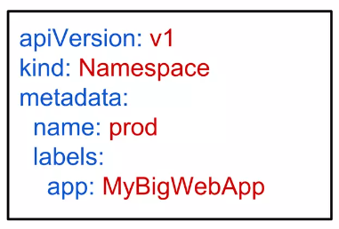
Core objects and APIs
Namespaces
- Namespaces are a logical cluster or environment and are the primary method of partitioning a cluster or scoping access.
Pods
Labels
Selectors
Services

Slide 12
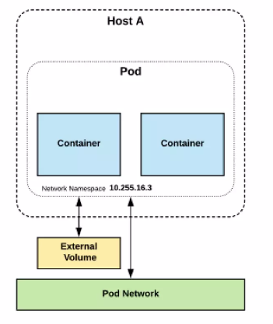
PODs
Atomic unit or smallest “unit of work” of Kubernetes.
Pods are one or MORE containers that share volumes and namespace.
They are also ephemeral!
Notes:
Edit Pods
A Note on Editing Existing Pods
In any of the practical quizzes, if you are asked to edit an existing POD, please note the following:
If you are given a pod definition file, edit that file and use it to create a new pod.
If you are not given a pod definition file, you may extract the definition to a file using the below command:
kubectl get pod <pod-name> -o yaml > pod-definition.yaml
Then edit the file to make the necessary changes, delete, and re-create the pod.
To modify the properties of the pod, you can utilize the kubectl edit pod <pod-name> command. Please note that only the properties listed below are editable.
spec.containers[*].image
spec.initContainers[*].image
spec.activeDeadlineSeconds
spec.tolerations
spec.terminationGracePeriodSeconds

Slide 13
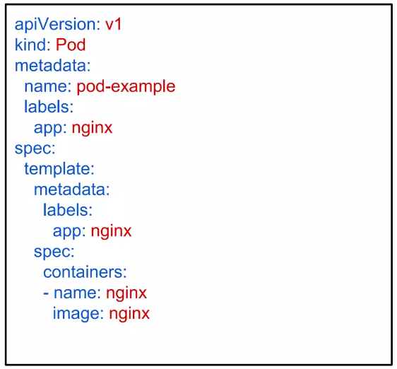
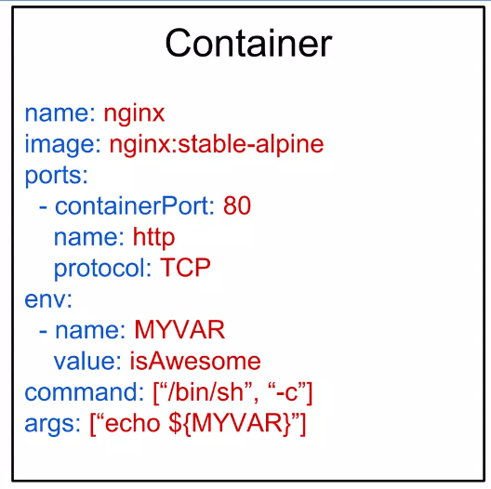
PODs
Key Pod Container Attributes
name - The name of the container
image - The container image
ports - array of ports to expose. Can be granted a friendly name and protocol may be specified
env - array of environment variables
command - Entrypoint array (equiv to Docker ENTRYPOINT)
args - Arguments to pass to the command (equiv to Docker CMD)

Slide 14
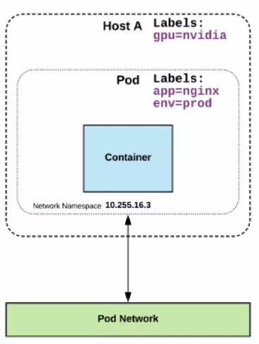
Labels
key-value pairs that are used to identify, describe and group together related sets of objects or resources.
NOT characteristic of uniqueness.
Have a strict syntax with a slightly limited character set*.
* https://kubernetes.io/docs/concepts/overview/working-with-objects/labels/#syntax-and-character-set

Slide 15
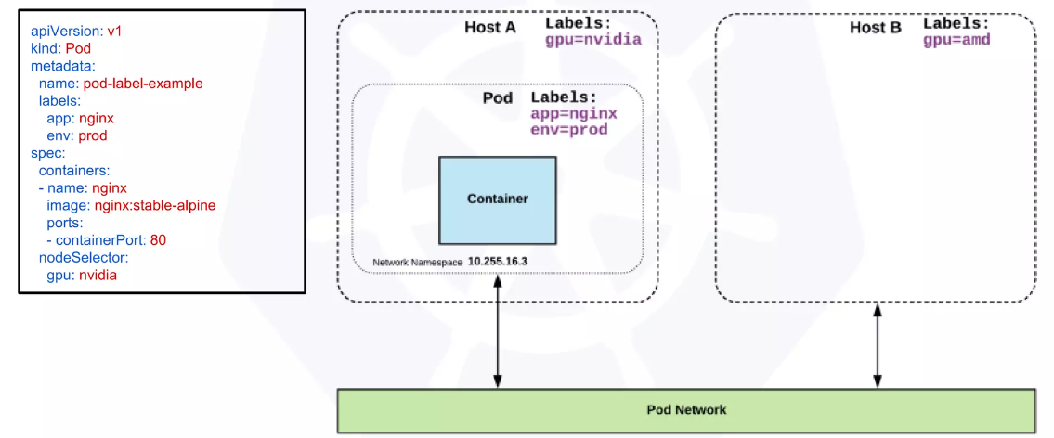
Selector
Selectors use labels to filter or select objects, and are used throughout Kubernetes.

Slide 16
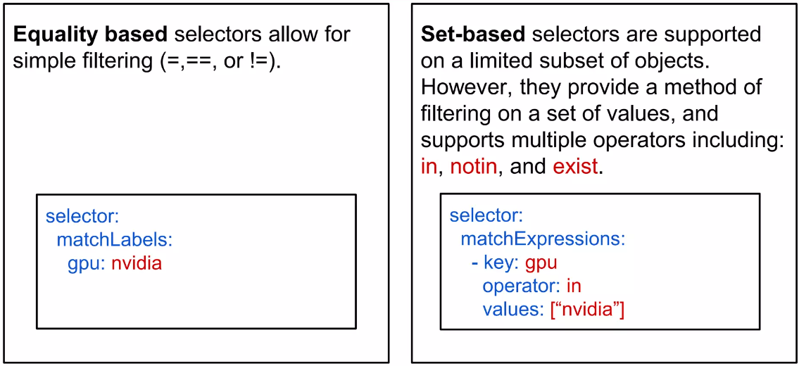
Selector Type

Slide 17
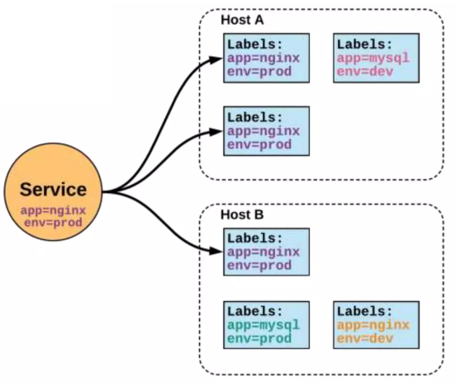
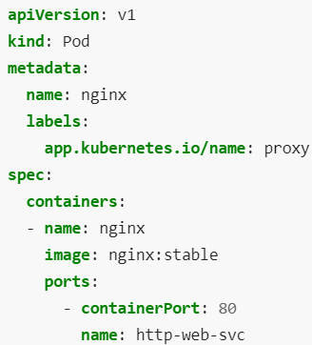
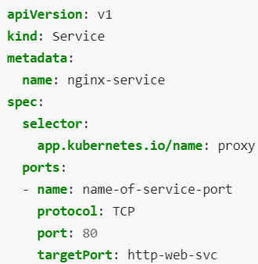
SERVICES
Unified method of accessing: the exposed workloads of Pods.
Durable resource
static cluster IP
static namespaced DNS name
Notes:
Kubernetes Services (kerno.io)
Implementing and Working With Kubernetes Services | by Vladimir Romanov | Medium

Slide 18
NETWORKING

Slide 19
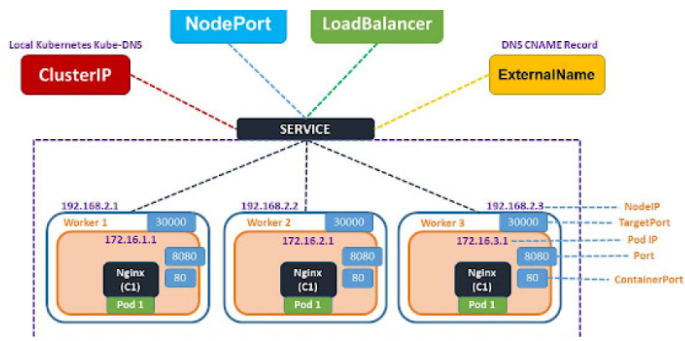
Service
Unified method of accessing the exposed workloads of Pods.
Durable resource (unlike Pods)
- static cluster-unique IP
- static namespaced DNS name
Target Pods using equality based selectors.
Uses kube-proxy to provide simple load-balancing.
kube-proxy acts as a daemon that creates local entries in the host’s iptables for every service.
Service Type: There are 4 major service types:
- ClusterIP (default)
- NodePort
- LoadBalancer
- ExternalName

Slide 20
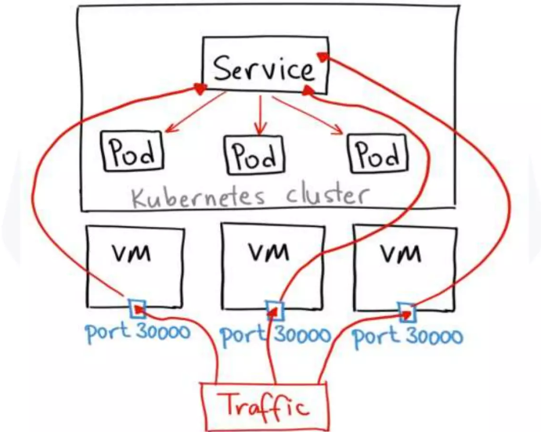
ClusterIP, Nodeport, Load balancer Service
ClusterIP
ClusterIP services exposes a service on a strictly cluster internal virtual IP.
Services are reachable by pods/services in the Cluster
NodePort
Services are reachable by clients on the same LAN/clients who can ping the K8s Host Nodes (and pods/services in the cluster) (Note for security your k8s host nodes should be on a private subnet, thus clients on the internet won't be able to reach this service)
Load balancer
Services are reachable by everyone connected to the internet* (Common architecture is L4 LB is publicly accessible on the internet by putting it in a DMZ or giving it both a private and public IP and k8s host nodes are on a private subnet)

Slide 21
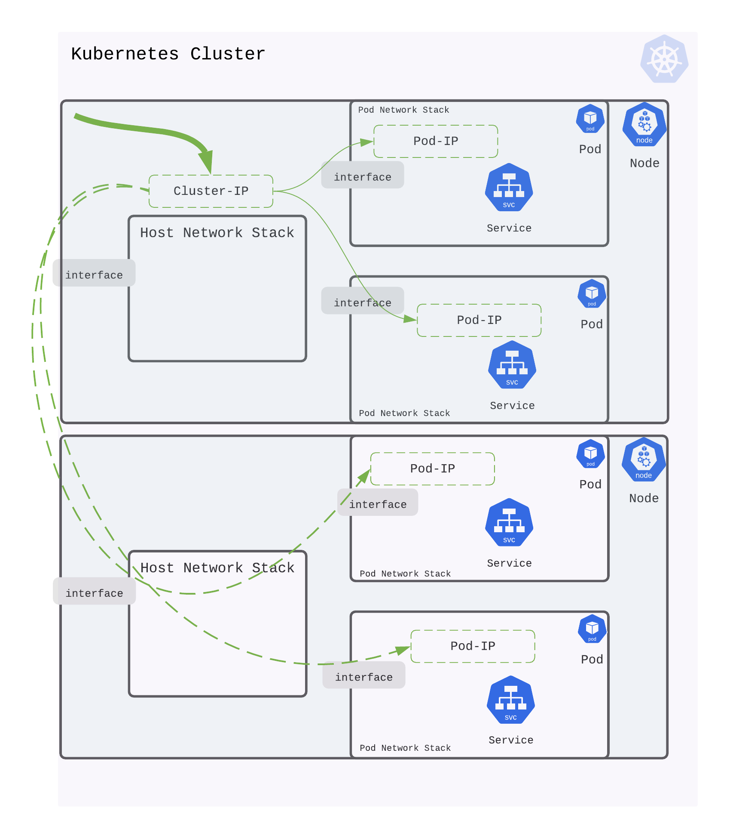
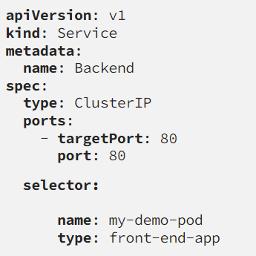
In Kubernetes, a Service is an abstraction that defines a logical set of Pods and a policy by which to access them. Think of it as a way to group related Pods together. The ClusterIP service type is one of the prominent services that enables communication among multiple Pods within the cluster.

Slide 22
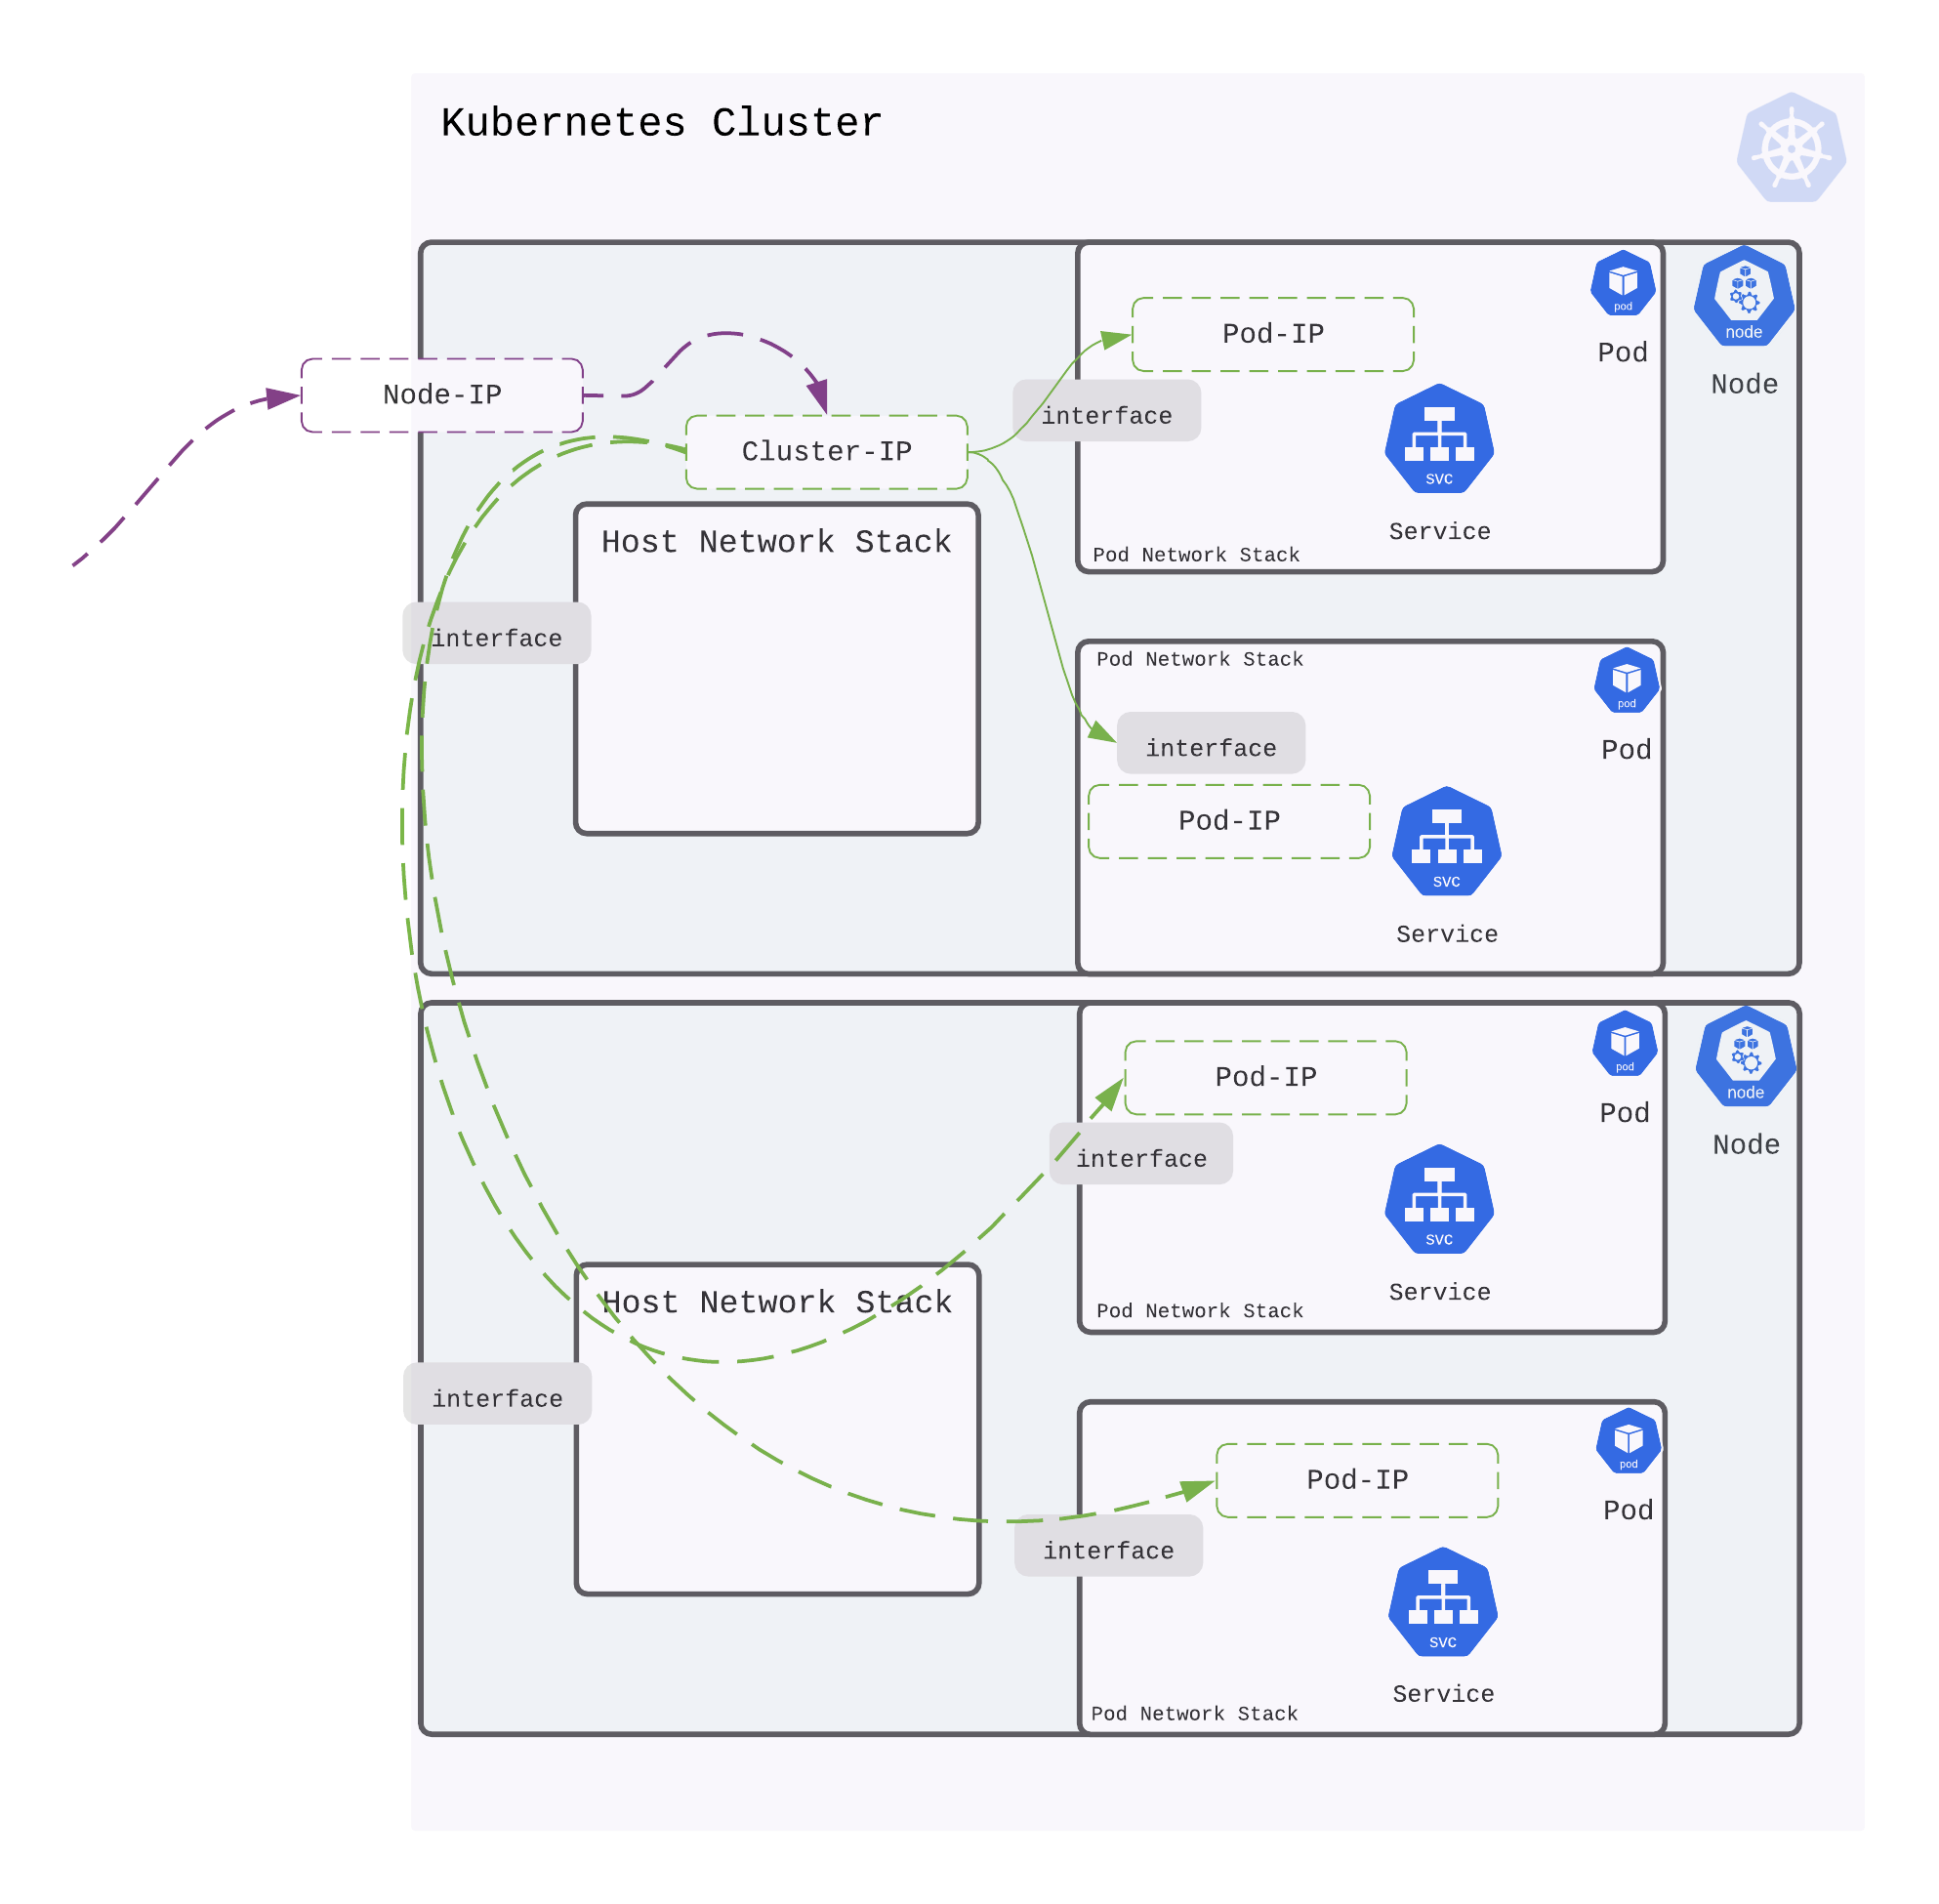
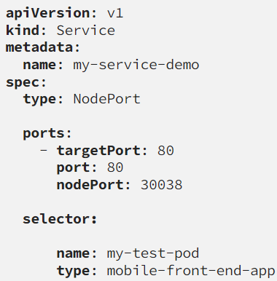
A NodePort is an open port on every node of your cluster. Kubernetes transparently routes incoming traffic on the NodePort, to your service, even if your application is running on a different node.
NodePort is assigned from a pool of cluster-configured NodePort ranges which typically lies in the range of 30000–32767.
Notes:
Understanding kubernetes networking: pods and services - devopstales

Slide 23
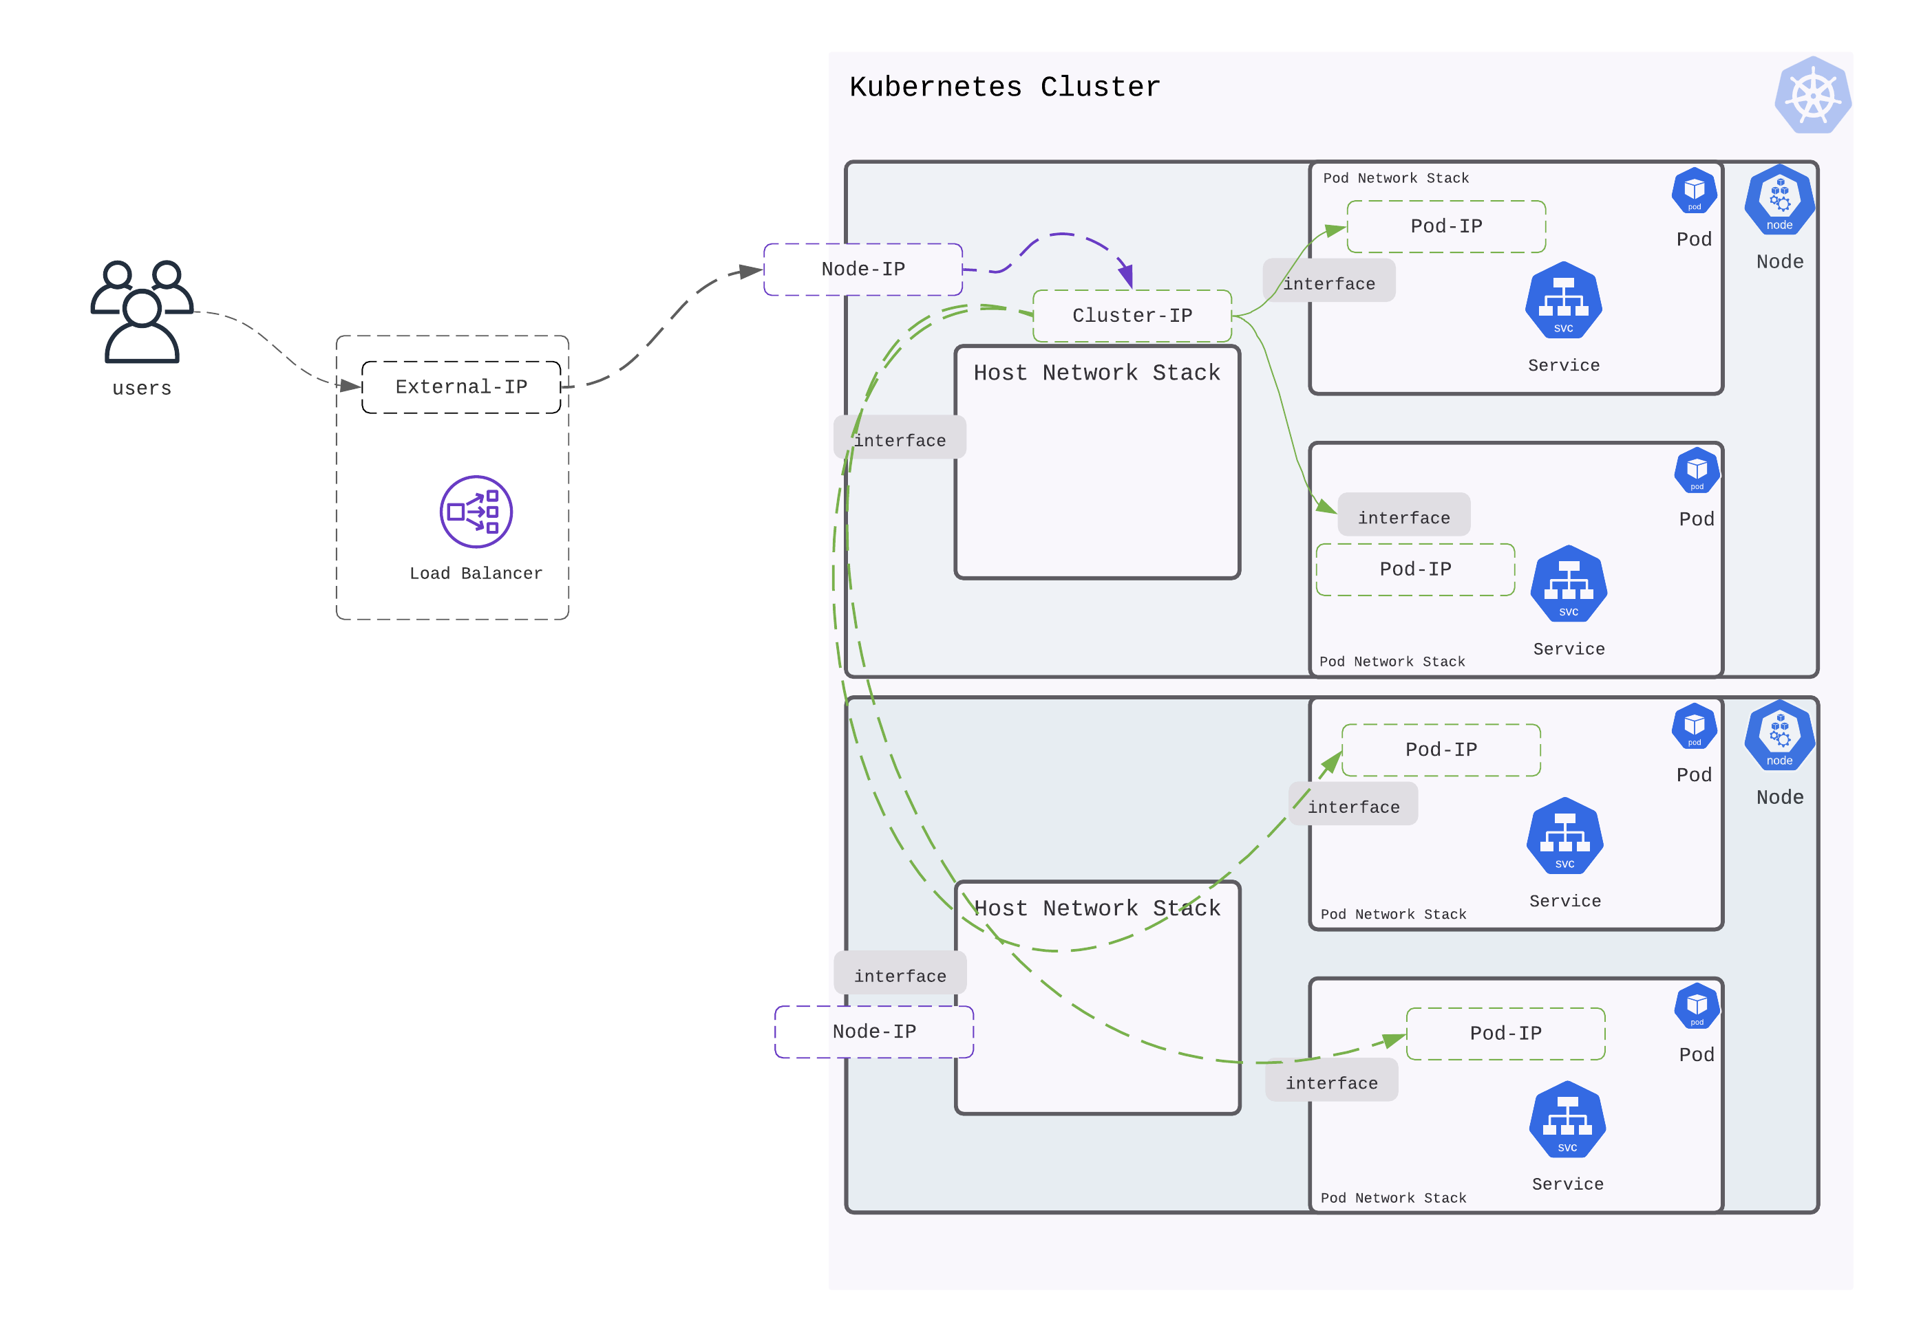

Slide 25
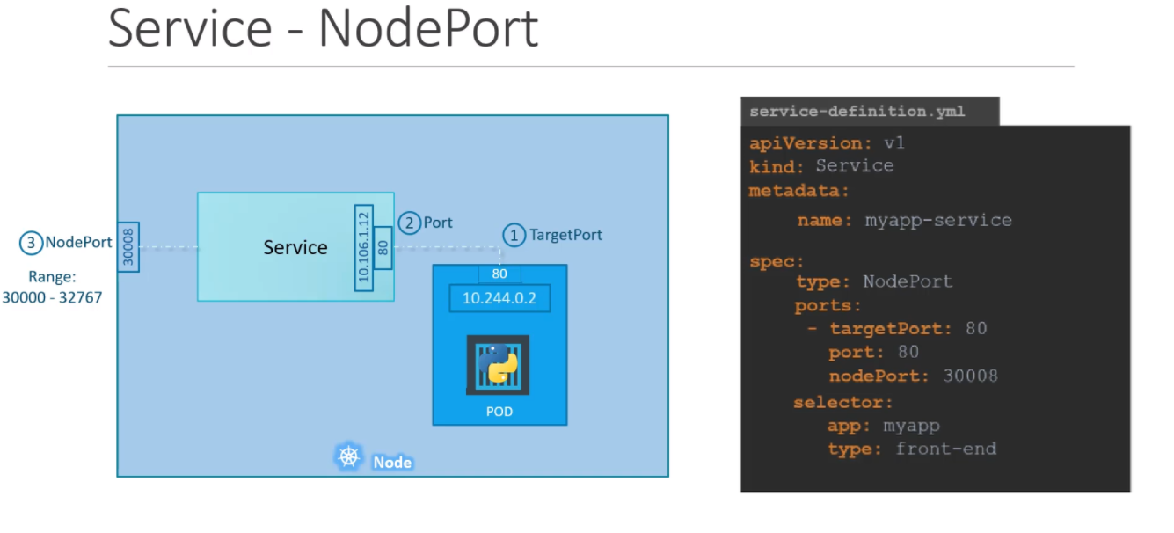

Slide 26
Communication
Container-to-Container
- Containers within a pod exist within the same network namespace and share an IP.
- Enables intra-pod communication over localhost.
Pod-to-Pod
- Allocated cluster unique IP for the duration of its life cycle.
Pod-to-Service
- managed by kube-proxy and given a persistent cluster unique IP
External-to-Service
- Handled by kube-proxy.
- Works in cooperation with a cloud provider or other external entity (load balancer).

Slide 27
Ingress

Slide 28
WORKLOADS

Slide 29
Workloads
ReplicaSet
- Always ensure the desired number of pods are running.
Deployment
DaemonSet
StatefulSet
Job
CronJob

Slide 30
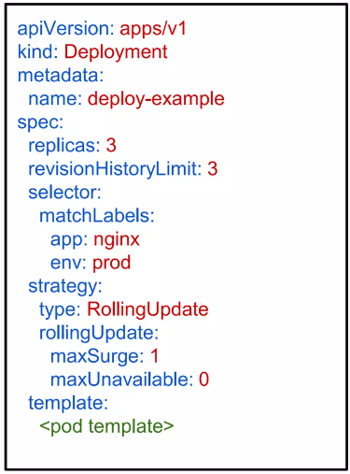
Deployment
revisionHistoryLimit: The number of previous iterations of the Deployment to retain.
strategy: Describes the method of updating the Pods based on the type. Valid options are Recreate or RollingUpdate.
Recreate: All existing Pods are killed before the new ones are created.
RollingUpdate: Cycles through updating the
Pods according to the parameters:
maxSurge and maxUnavailable.
Blue Green Deployment Strategy
STEP 1: SETTING UP A LOAD BALANCER
To route the traffic instantaneously to the green instance.
STEP 2: EXECUTING THE UPDATE
The green instance is deployed in the production environment.
STEP 3: TO MONITOR THE ENVIRONMENT
The developers conduct smoke tests on the new update.
STEP 4: DEPLOYMENT OR ROLLBACK
If any problem is noticed, it is immediately rolled back and traffic is redirected.
Canary Deployments
The idea here is to first deploy the change to a small subset of users, test it,
and then roll the new changes out to the rest of the users on successfully passing
the defined tests.

Slide 31
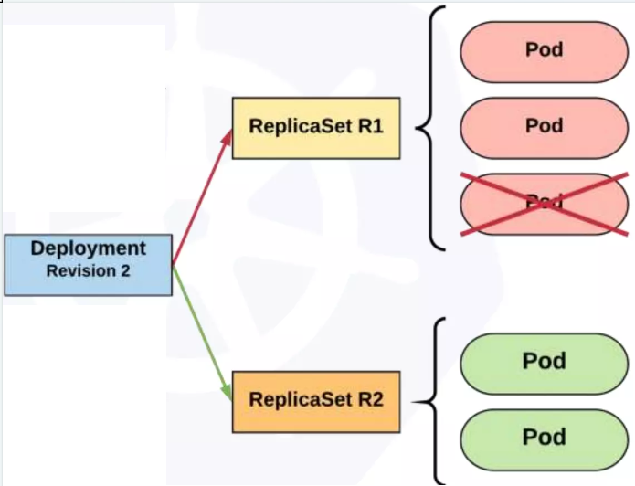
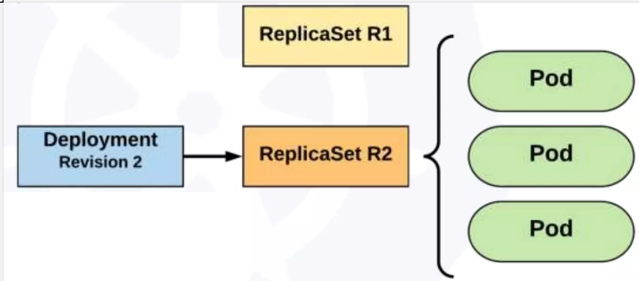
Rolling Update Deployment

Slide 32
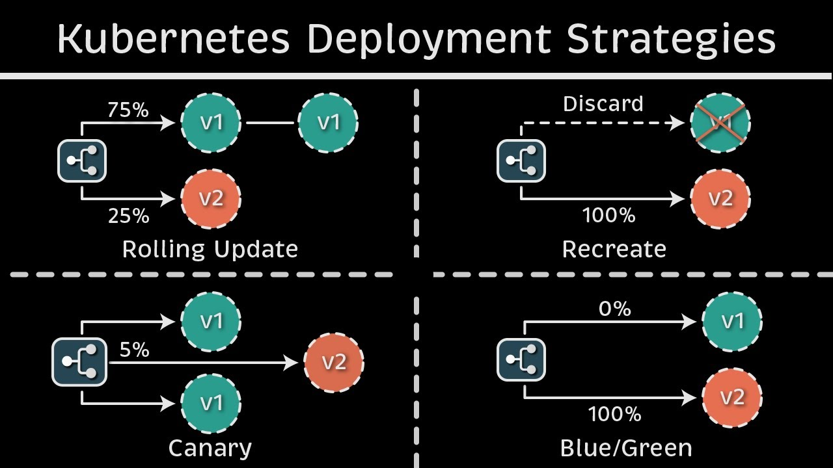

Slide 33

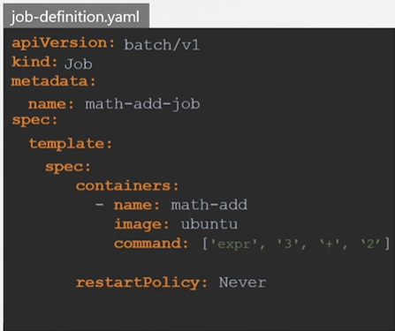
JOB
Definition: A Kubernetes Job creates one or more pods to perform a specific task that runs to completion.
Purpose: To handle batch processing and short-lived tasks that need to run only once or a finite number of times.
Job vs. CronJob:
job: run once or a specified number of times
CronJob: scheduled to run at specific times
completions subfield: Determines the desired number of successfully finished pods a Job should have. For example, if you set completions to 5, Kubernetes will ensure that five Pods have completed successfully.
parallelism subfield: Determines the maximum number of Pods that can run in parallel. For example, if you set parallelism to 2, Kubernetes will ensure that no more than two pods are running at the same time.

Slide 34

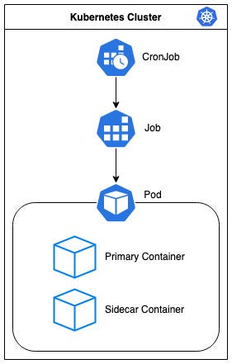
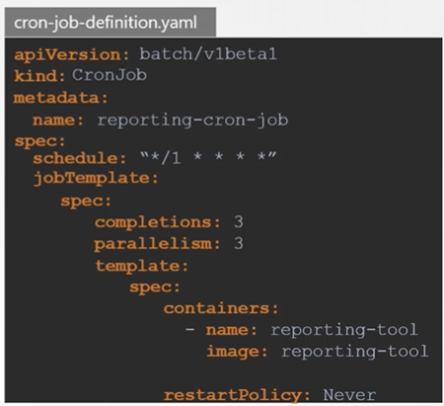
Cron Job
Cron jobs are a powerful tool for automating repetitive tasks and streamlining system maintenance. With the help of Kubernetes, we can easily create and manage Cron jobs to perform various tasks such as database updates, report generation, and data fetching from external APIs.

Slide 35
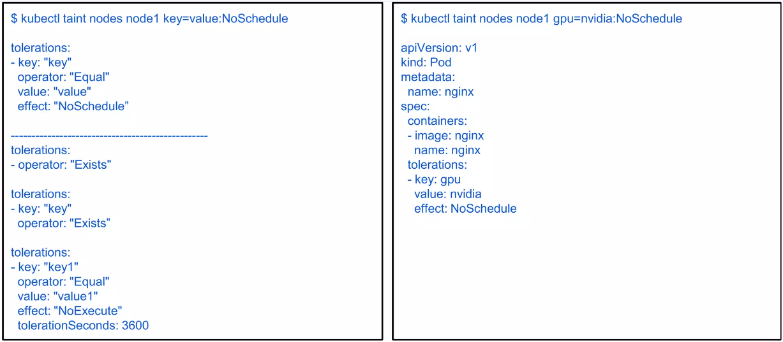
Taints & Tolerations
Notes:
https://www.youtube.com/watch?v=mo2UrkjA7FE

Slide 36
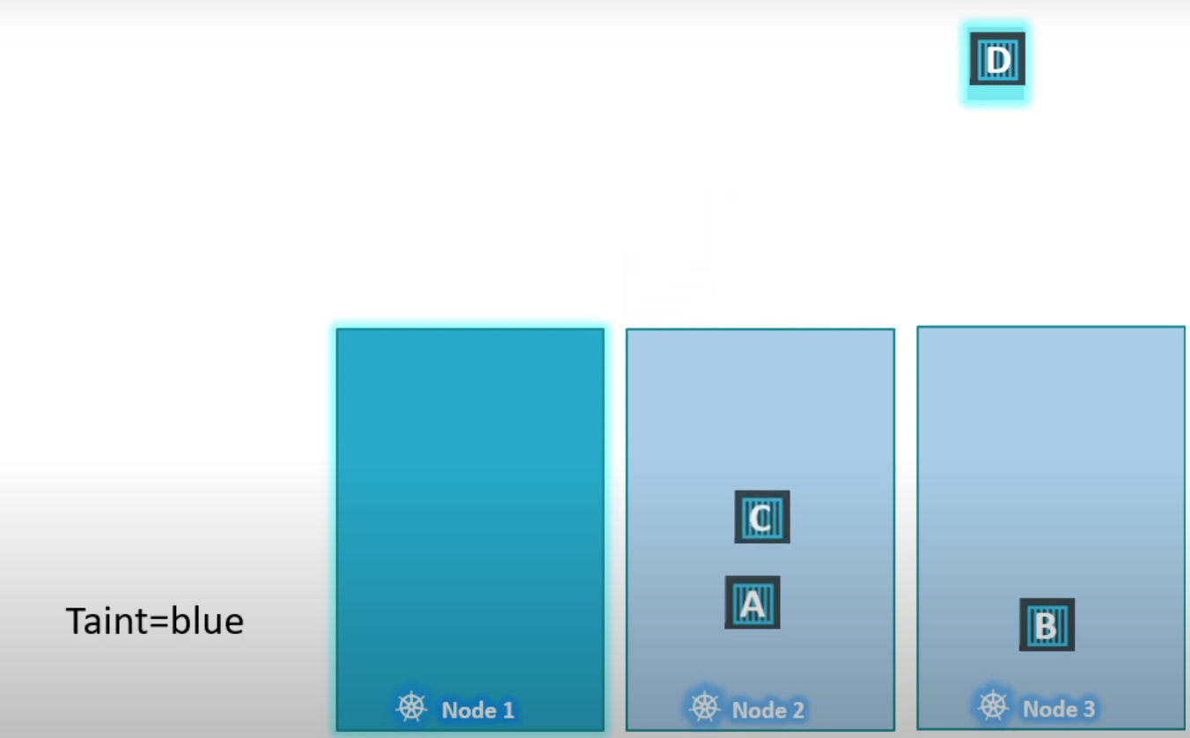
Taints & Tolerations continue..

Slide 37
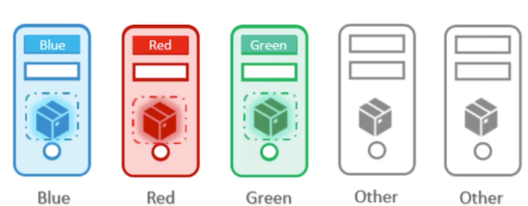
Taints Tolerations & Node Affinity
Combination of Taints/Tolerations and Node affinity rules can be used together to completely dedicate nodes for specific pods.
We first use Taints and Tolerations to prevent other pods from being placed on our nodes and then we use Node Affinity to prevent our pods from being placed on other nodes.

Slide 38
Configuration

Slide 39
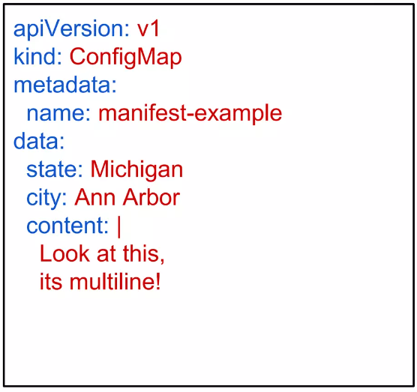
Configuration: Config Maps
Kubernetes has an integrated pattern for decoupling configuration from application or container.
This pattern makes use of two Kubernetes components: ConfigMaps and Secrets.
ConfigMaps
Externalized data stored within Kubernetes.
Can be referenced through several different means:
environment variable
a command line argument (via env var)
injected as a file into a volume mount
Can be created from a manifest, literals, directories, or files directly.

Slide 40
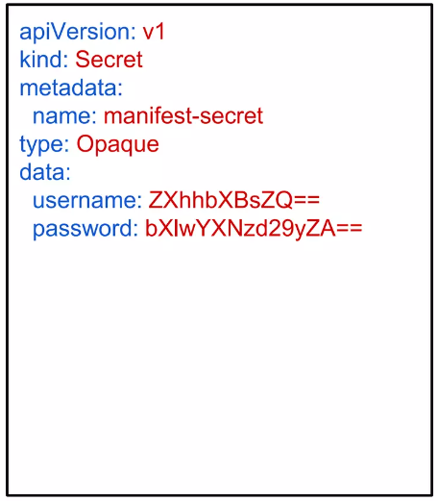
Configuration: Secret
Functionally identical to a ConfigMap.
Stored as base64 encoded content.
Encrypted at rest within etcd (if configured!).
Stored on each worker node in tmpfs directory.
Ideal for username/passwords, certificates or other sensitive information that should not be stored in a container.
Example:
type: There are three different types of secrets within Kubernetes:
docker-registry - credentials used to authenticate to a container registry
generic/Opaque - literal values from different sources
tls - a certificate based secret
data: Contains key-value pairs of base64

Slide 41
Resource Quota

Slide 42
Resource Quota
Namespace
A namespace is a virtual cluster within a Kubernetes cluster that provides a way to divide and isolate resources. Resource quotas are applied at the namespace level.
Resource Types
Kubernetes allows you to define quotas for various resource types, including CPU (measured in CPU units or cores) and memory (measured in bytes or other units). Quotas can also be set for persistent volume claims and the number of objects like pods, services, and secrets.
Quota Specifications
A resource quota is defined by specifying the maximum amount of each resource that can be consumed within a namespace. For example, you can set a CPU limit of 4 cores and a memory limit of 8 GB for a particular namespace.

Slide 43
Continue…
Hard and Soft Limits
Quota specifications can have both hard and soft limits. The hard limit defines the maximum allowed resource usage and once reached, it prevents any further resource allocation. The soft limit, also known as the “quota limit,” serves as a warning threshold. It triggers notifications but doesn’t enforce any action.
Request and Limit
In Kubernetes, each pod specifies the amount of CPU and memory it requests (known as “request”) and the maximum it can consume (known as “limit”). The sum of requests and limits of all pods within a namespace is used to calculate resource utilization against the quota.
Resource Quota Enforcement
Kubernetes enforces resource quotas by rejecting new pod creations or updates that exceed the defined limits. Pods already running before the quota is enforced continue to run but are not allowed to exceed the limits.

Slide 44
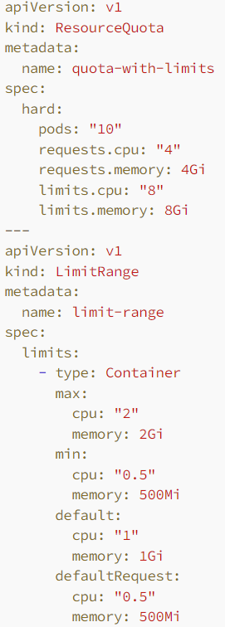
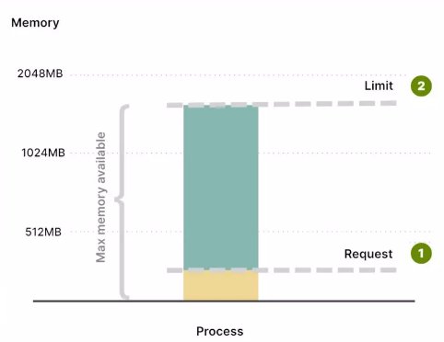
Again continue…
Resource Quota Scopes
Kubernetes supports two types of quota scopes. Cluster-scoped quotas apply to all namespaces in the cluster, while namespace-scoped quotas are specific to a particular namespace.

Slide 45
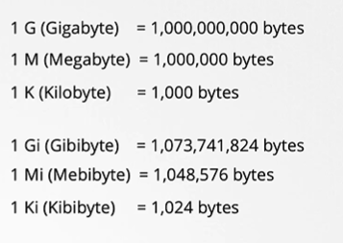
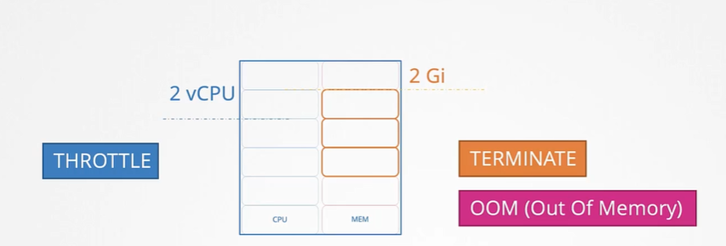
Request & Limits

Slide 46
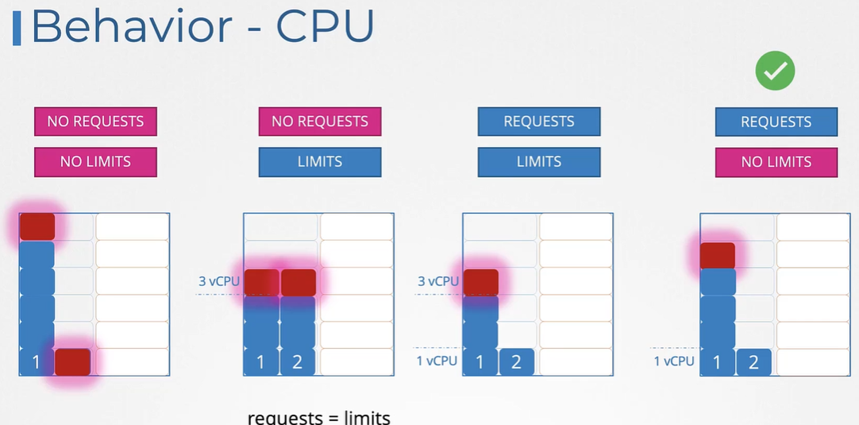

Slide 47
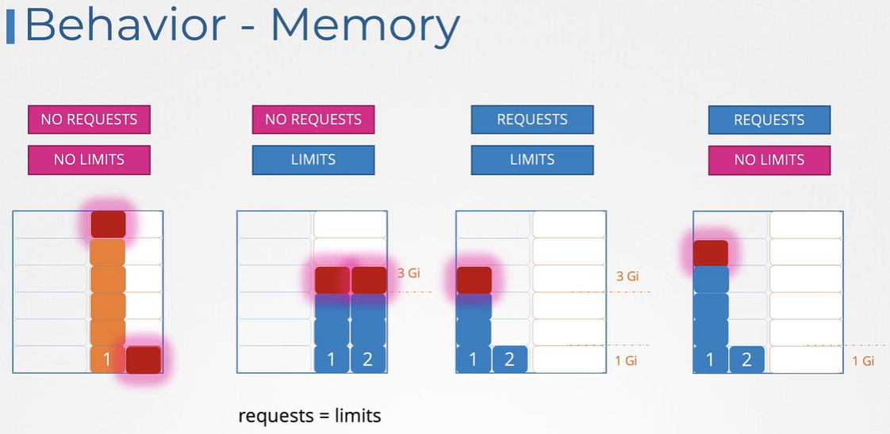

Slide 48
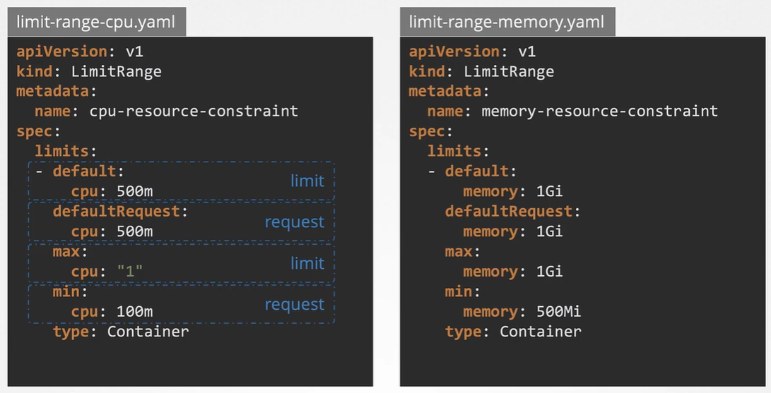
Limit Range at Namespace level for POD

Slide 49
How to evaluate resource quota in .Net Application
Benchmark Your Application:
Start by benchmarking your application to understand its typical and peak resource usage. You can do this by running performance tests or load tests against your application in a controlled environment.
Monitor Resource Usage
Deploy your application to a single pod in Kubernetes and monitor its resource usage under various loads. Use monitoring tools like Prometheus and Grafana to track the CPU and memory usage over time1.
Set Resource Requests and Limits
Based on the monitored data, set the resource requests to the average resource usage of your application and the limits to the maximum usage observed during peak loads. This will ensure that your application has enough resources while preventing it from consuming excessive resources that could affect other applications1.

Slide 50
Continue…
Use LimitRange and ResourceQuota
Implement a LimitRange to set default CPU and memory requests and limits for all pods in a namespace if not specified. Then, define a ResourceQuota to enforce the total resource consumption for that namespace2.
Iterate and Adjust
After applying the initial quotas, continue to monitor your application’s performance and resource usage. Adjust the quotas as necessary based on the observed data and any changes in the application’s behavior or workload.
Consider Garbage Collection (GC) Configuration
For .NET Core applications, you may need to configure the GC to work with the memory limits set by Kubernetes. You can do this by setting the COMPlus_GCHeapHardLimit environment variable to limit the heap size1.
Notes:
https://stackoverflow.com/questions/55549129/how-to-limit-memory-size-for-net-core-application-in-pod-of-Kubernetes

Slide 51
K8s Probes
Notes:
Kubernetes — Probes (Liveness, Readiness, and Startup) Overview | by Ashish Patel | DevOps Mojo | Medium

Slide 52
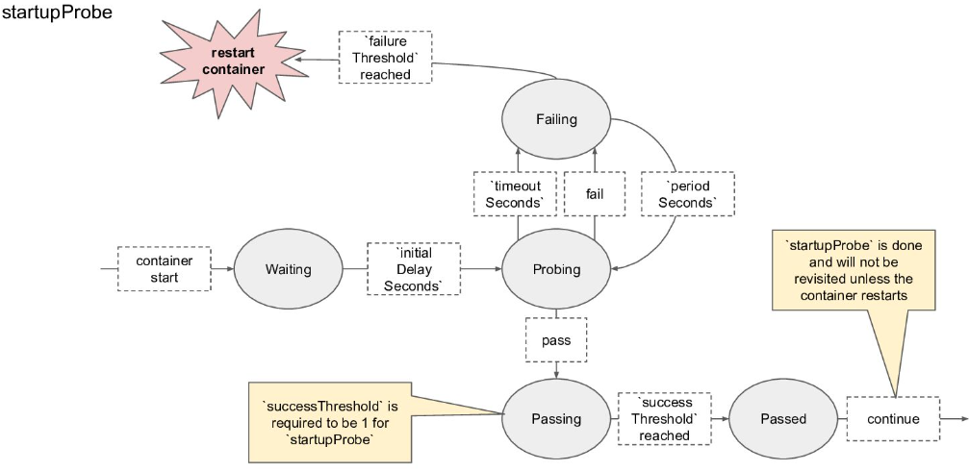
Start-Up Probe

Slide 53
Start-up probe
To know when a container application has started
It disables liveness and readiness checks until it succeeds
Can be used to adopt liveness checks on slow starting containers

Slide 54
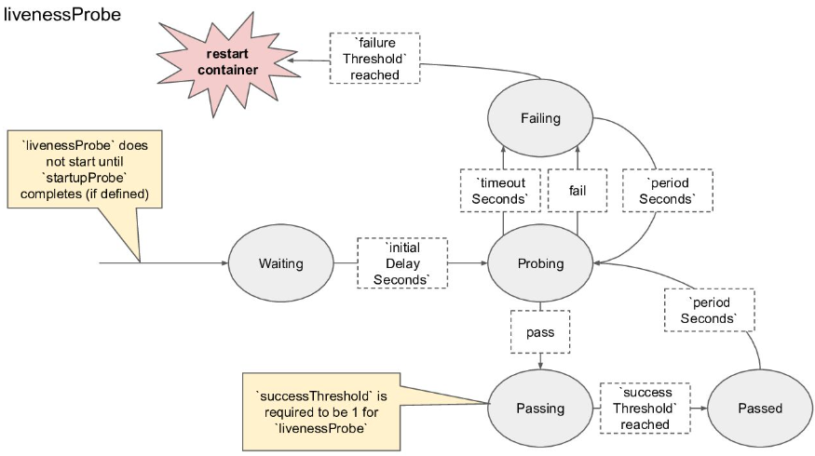
Liveness Probe

Slide 55
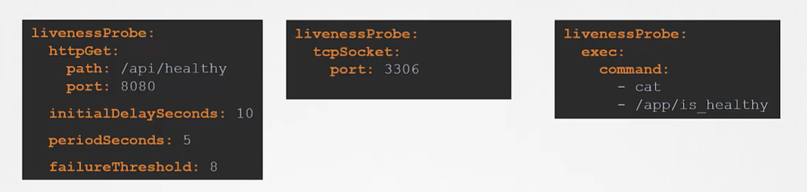
Liveness Probe
Used by Kubelet
To know when to restart the container
Catching a Deadlock
Despite App’s Bugs

Slide 56
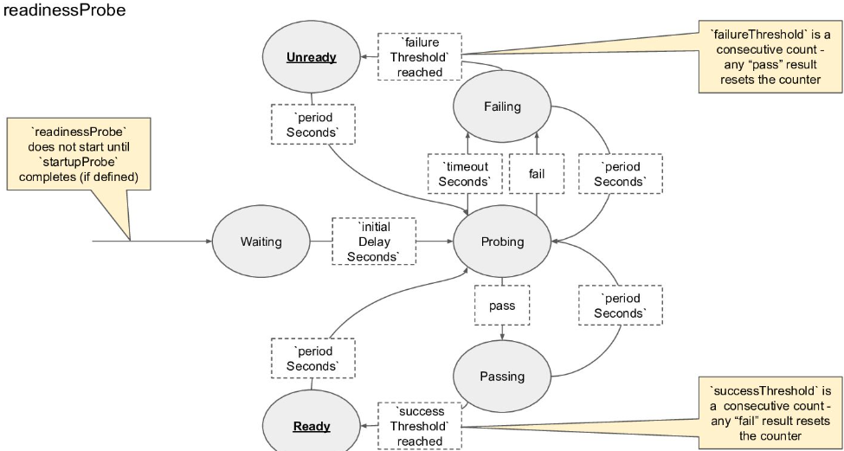
Readiness Probe

Slide 57
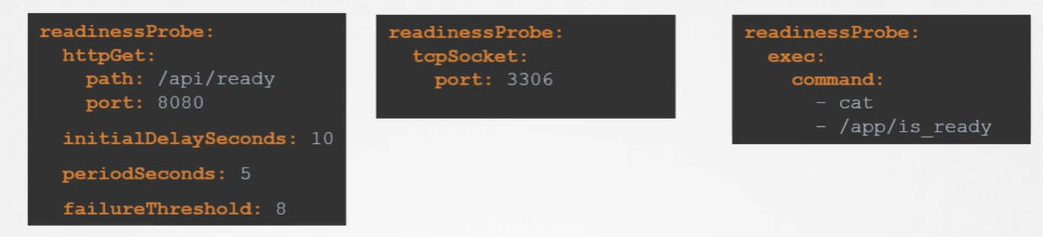
Readiness Probe
Used by Kubelet
To know when a container is ready to start accepting traffic
When all of its containers are ready
Unlike a liveness probe, a readiness probe doesn’t kill the container. If the readiness probe fails, Kubernetes simply hides the container’s Pod from corresponding Services, so that no traffic is redirected to it.
Liveness probes do not wait for readiness probes to succeed. If you want to wait before executing a liveness probe you should use initialDelaySeconds or startupProbe.
A side-effect of using Readiness Probes is that they can increase the time it takes to update Deployments.

Slide 58
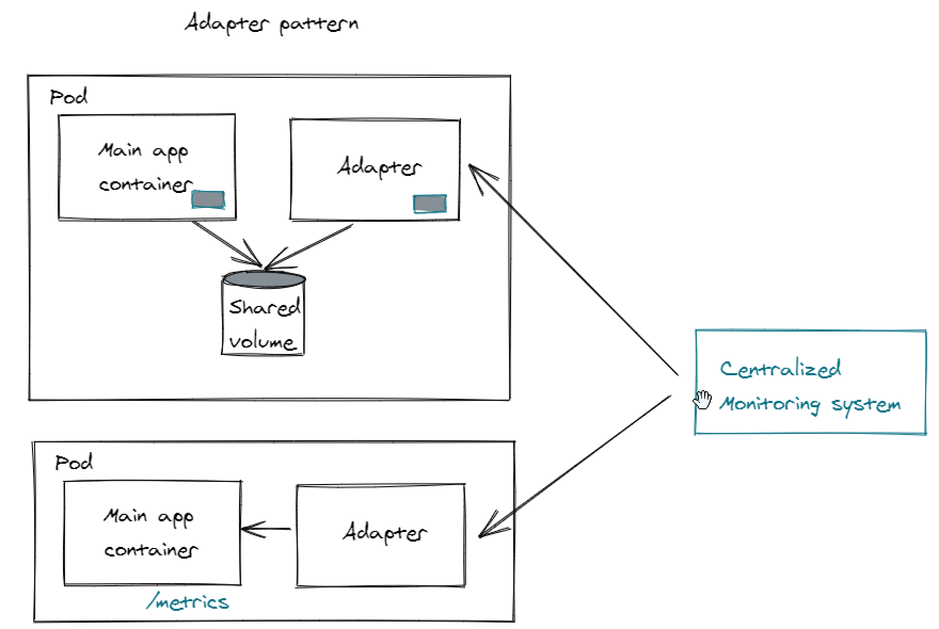


Container patterns
Pattern | Description
Sidecar | An additional container in the same pod that enhances or extends the functionality of the main container. For example, a logging agent alongside the main application container.
Ambassador | A container that acts as a proxy to other parts of the system. It handles network connections for the main container. Common use cases include authentication to external services or proxying to a Redis caching cluster.
Adapter | A container that transforms the output of the main container. It modifies or adapts data before it’s sent out.
Notes:
Patterns: Sidecars, Ambassadors, and Adapters Containers | by Vittorio Nardone | The Startup | Medium
Talk: Kubernetes multi-container patterns | Raghav Ramesh

Slide 59
Volume

Slide 60




Kubernetes Volumes
Persistent Volumes (PV)
Definition: A PV is a storage unit in the cluster provisioned by an administrator.
Lifecycle: The PV lifecycle is independent of any individual pod.
Support for Multiple Backends: PV supports various storage backends like GCEPersistentDisk, AWSElasticBlockStore, AzureDisk, etc.
Kubernetes Volumes Functionality
Types of Kubernetes Volumes
Persistent Volume Claim (PVC)
Persistent Volume (PV)
Persistent Volume Claims (PVC)
Definition: PVC is a user's storage request to Kubernetes.
Configuration: PVCs allow requesting specific sizes and access modes.
Usage: PVCs are utilized to consume PV storage resources.
Facilitates storage access for containers within Kubernetes. Unlike Docker volumes, they are linked to the pod's lifecycle.
Varieties include emptyDir, hostPath, nfs, etc., offering diverse storage options for different needs.
A request for storage by users, abstracting underlying storage details, and allowing dynamic provisioning.
Storage provision independent of pod lifecycle, can be dynamically provisioned or pre-provisioned by administrators.

Slide 61

How PV and PVC Work Together
PVC Requesting PV
PVC specifies storage requirements, such as access mode and capacity, requesting a suitable PV.
Binding PV to PVC
Once a PV is claimed, it is bound to the requesting PVC based on compatibility with defined storage.
Dynamic Provisioning
Automatic creation of PVs based on PVC requirements, streamlining storage management in Kubernetes clusters.
PV Mounting to Pods
Mounted PVs provide containers in pods with access to persistent storage across cluster restarts and rescheduling.
Efficient Resource Utilization
Optimizing storage resources by dynamically allocating PVs to PVCs and recycling unused resources efficiently.
Storage Classes
Grouping of PVs with similar characteristics to simplify storage provisioning and management based on workload needs.

Slide 62
Volume Access modes
ReadWriteOnce (RWO) Access Mode: Definition: Volume can be mounted as read-write by a single node Use Cases: Suitable for applications with single-node access Limitations: Cannot be accessed by multiple nodes simultaneously | ReadWriteMany (RWX) Access Mode: Definition: Volume can be mounted as read-write by multiple nodes simultaneously. Use Cases: Ideal for distributed applications needing concurrent write access across nodes. Limitations: Dependent on underlying storage that supports multiple read-write clients. | ReadOnlyMany (ROX) Access Mode: Definition: Volume is mounted in read-only mode across multiple nodes, ensuring data integrity. Use Cases: Ideal for scenarios requiring shared data that must remain unaltered and consistent. Limitations: Write operations are restricted, preventing modifications to the shared data.
#1 ReadWriteOnce
Volume can be mounted as read-write by a single node
#2 ReadOnlyMany
Volume can be mounted as read-only by many nodes
#3 ReadWriteMany
Volume can be mounted as read-write by many nodes
#4 NodeAffinity
Control over which node the volume can be mounted on
#5 NodeAntiAffinity
Prevents the volume from being mounted on specific nodes

Slide 63


Use PVs: Statically Create a PV
Step 1) A cluster administrator creates an NFS PV. NFS is a type of in-tree storage natively supported by Kubernetes. The YAML file is as follows:
Notes:
Kubernetes Persistent Storage Process - Alibaba Cloud Community

Slide 64


Continue: Statically Create a PV
Step 2) A user creates a PVC. The YAML file is as follows:
Step 3) The user creates an application and uses the PVC created in Step 2.

Slide 65


Use PVs: Dynamically Create a PV
The cluster administrator only needs to ensure that the environment contains an NFS-related StorageClass.

Slide 66

Continue: Dynamically Create a PV
Step 2) The NFS client provisioner in the cluster dynamically creates the corresponding PV. A PV is created in the environment and bound to the PVC.
Step 1) The user creates a PVC and sets storageClassName to the name of the NFS-related StorageClass.
Step 3) The user creates an application and uses the PVC created in Step 2. This step is the same as Step 3 of statically creating a PV.

Slide 67


Slide 68
Provisioning Volumes controller
PV Status Changes (UpdatePVStatus)
The PV starts in the Available state and changes to the Bound state after being bound to the PVC.
The PV changes to the Released state after the bound PVC is deleted.
The PV changes to the Available state when the PV reclaim policy is Recycled or the .Spec.ClaimRef of the PV is manually deleted.
The PV changes to the Failed state when the PV reclaim policy is unknown, the recycle operation fails, or the volume cannot be deleted.
PVC Status Changes (UpdatePVCStatus)
The PVC changes to the Pending state when the cluster does not include any PV that matches the PVC. The PVC changes from the Pending to the Bound state after it is bound to a PV.
The PVC changes to the Lost state when the bound PV is deleted from the environment.
The PVC changes to the Bound state after it is bound to a PV with the same name as that of the previous PV.

Slide 69
https://www.slideshare.net/rishabhindoria52/introduction-to-kubernetes-139878615
https://www.youtube.com/watch?v=4C-0idGOi2A

Slide 70
Links
Open Shift Projects · Red Hat OpenShift (mms.local)
Prerequisite - Common Pre-Requisite Tasks - Platform - OpenShift - Microlise Confluence
Openshift Documentation - Overview - Platform - OpenShift - Microlise Confluence
NameSpace Creation - asset-tag-dev.yml - Microsoft Team Foundation Server (microlise.com)
Quay Setup - repositories_microlise_build.yml - Microsoft Team Foundation Server
Container Image Creation - Containerfile - Microsoft Team Foundation Server (microlise.com)
Container Image Build
Release Project Creation and deployment - AssetTagApi.Release - Microsoft Team Foundation Server (microlise.com)
AssetTagApi.Release - Microsoft Team Foundation Server (microlise.com)

Slide 71

Any Questions?

Slide 72
Thank You

